Slide 1
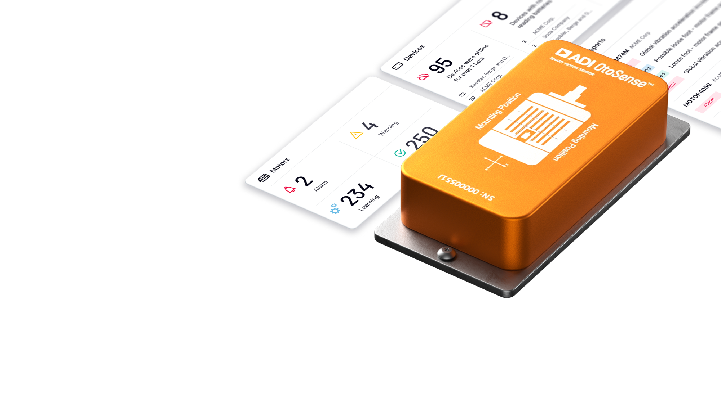
PARTNER LOGO
HERE
Industry 4.0 & The Power of Smart Motor Sensors
February 2022

Slide 2

Contents
PARTNER LOGO
HERE
Introducing Analog Devices
Introducing Partner Name
Industry 4.0 and Challenges
Solution Overview
Case Studies and Results
Next Steps

Slide 3
Enabling Customers to Shape the Future
Through More Complete Hardware, Software and System Solutions
PARTNER LOGO
HERE
125K+
We engineer elegant solutions that convert physical signals at the edge into digital intelligence in the cloud, taming design complexity and accelerating solution breakthroughs to ensure a more connected, healthier and greener future for generations to come.
Customers
10K+
Engineers
$1.5B+*
R&D
Investment
$9.1B*
Annual
Revenue
~70
Design Centers
~6.5K
75K+
Patents
SKUs
*Unaudited, pro forma data based on ADI's and Maxim's SEC filings as of
July 31, 2021 and June 26, 2021 respectively.

Slide 4
Partner Overview
PARTNER LOGO
HERE
Information about Partner goes here.
Insert Image representing partner on the right -→

Slide 5
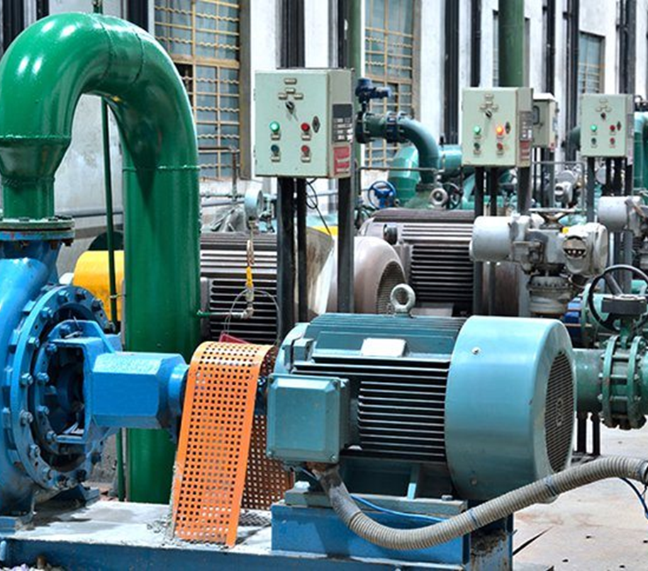
In Manufacturing, millions of low-voltage motors operate unmonitored
PARTNER LOGO
HERE
Inefficiencies
Unplanned downtime
Production interruption
Product spoilage
Notes:
Why did we target Electric Motors? Because motor systems are an integral part of industrial facilities. They provide the motive force behind the fans, pumps, compressors, chillers, and conveyors in these facilities. Without access to real-time health and operation of the motor, it may not run in an optimal manner, which impacts its efficiency, hence its power consumption; it also impacts the load performance, and worse, when the motor fails, it can be responsible for the stoppage of the whole process operation, impacting the production and sometimes the quality / reliability of the products produced. In the US alone, 14 millions of unplanned downtime happen due to system failures each year in industrial facility (*U.S. Industrial and Commercial Motor System Market Assessment Report)

Slide 6


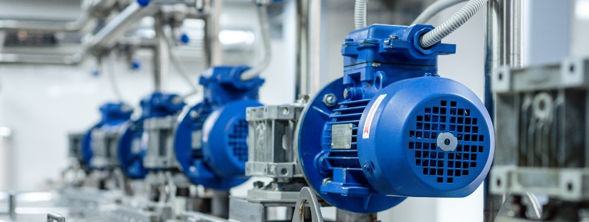
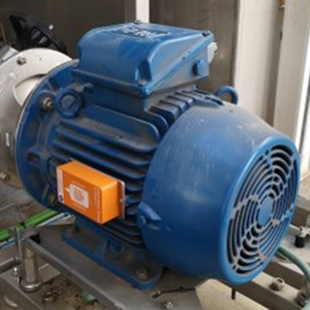
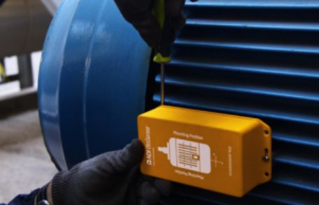

Maintenance, Operating and Warranty Costs Present a Continuing Challenge
PARTNER LOGO
HERE
Challenges
Ideal Solution
Desired Outcomes
Millions of low voltage motors operate unmonitored, impacting the motor efficiency, process operation and load performance.
Smart Motor Sensor is an AI based, turnkey HW/SW solution that helps avoid downtime
and optimize maintenance cost. The device
sends sensing data to Azure where AI provides diagnostics and delivers prescriptive
maintenance actions.
Improve asset predictive maintenance throughout WW factories.​
Generate cost savings from maintenance efficiencies.
Continuously monitor ensures process stability.

Slide 7

What If You Could ….
PARTNER LOGO
HERE
Anticipate Downtime
  Reduce unforeseen downtimes & avoid catastrophic failures
  Optimize motor efficiency
Improve Maintenance Planning
  Better manage spare parts and stock
  Reduce route-based activities & optimize maintenance resource allocation
Reduce Overhauls
  Extend period between overhauls
  Increase the lifetime of your equipment
Notes:
Why did we target Electric Motors? Because motor systems are an integral part of industrial facilities. They provide the motive force behind the fans, pumps, compressors, chillers, and conveyors in these facilities. Without access to real-time health and operation of the motor, it may not run in an optimal manner, which impacts its efficiency, hence its power consumption; it also impacts the load performance, and worse, when the motor fails, it can be responsible for the stoppage of the whole process operation, impacting the production and sometimes the quality / reliability of the products produced. In the US alone, 14 millions of unplanned downtime happen due to system failures each year in industrial facility (*U.S. Industrial and Commercial Motor System Market Assessment Report)

Slide 8
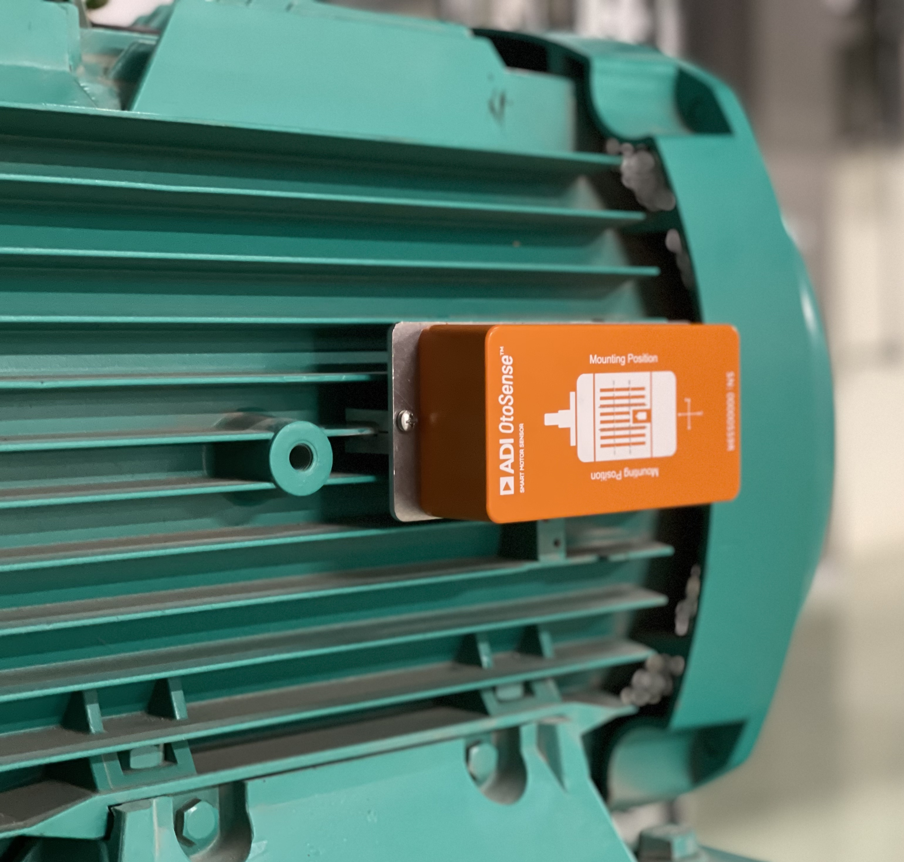

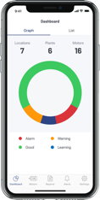

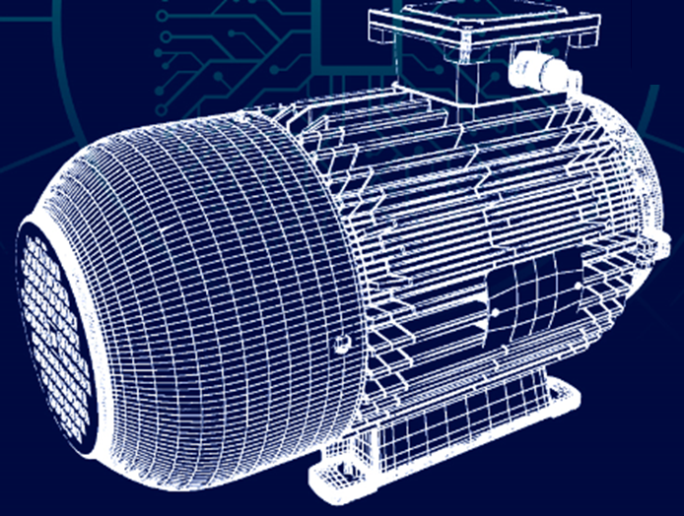




Turnkey AI-Based Hardware and Software Solution
Solution: turnkey AI-based Hardware and Software solution
PARTNER LOGO
HERE
011000010110111001100001011011000110111101100111001000000110010001100101011101100110100101100011011001010111001100100000011100110110010101100011011100110010
Sensing Technologies
High performance sensors deliver higher quality data for analysis
Advanced Diagnostics
Notifications, diagnostic updates and recommendations provided through web and mobile applications
Machine Learning
Securely sends data to the cloud to diagnose critical electrical and mechanical motor faults
Notes:
SMS is a wireless connected sensing module that monitors the status and health of low voltage induction motors. It’s a service where you get the hardware to collect information and a license to receive the actionable insights.
The device is installed on the motor, using fixing clamps. It is commissioned using a mobile application and dedicated to the motor you install it onto. It’s easy mounting, noon-invasive, and the device is configured and installed within minutes.
There are 5 sensors inside the orange box: 2 ADI temperature sensors to collect information about the external frame of the device and about its environment. There are also 2 ADI ADXL1002 accelerometers that are high frequency bandwidth, low noise accelerometers, best in-class vibration sensors, to allow for a precise diagnostic. And 1 magnetic flux sensor to detect the electric faults of the motor. Best-in-class sensors and sensor processing technologies, designed by ADI for industrial applications, deliver high quality data for diagnostics​
So, once launched, the SMS measures temperature, vibration and magnetic field and sends the data to the ADI cloud server over a secure wi-fi connection. The communication is done through secure connection (Wifi WPA2 and MQTT), using industry best practice for the . No wires, no additional gateways needed: Limited infrastructure requirements improve reliability of system operation​
2. At first, SMS will go through a learning process to build a digital twin of the motor in its environment and working conditions, so a layer of machine learning is added to the physics-based model. This twin will be used as a reference to analyze the incoming data once the learning is over. The license is purchased by SMS, so we keep the historic of a given motor. (still the device can be decommissioned and reattributed to another motor if needed).
3. When a fault is detected, notifications, diagnostic updates and recommendations are provided through web and mobile app. Because it correlates data coming from multiple best-in class sensors, SMS diagnostics is more reliable, minimizing potential for false positives​.

Slide 9



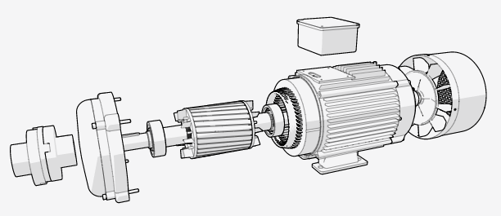
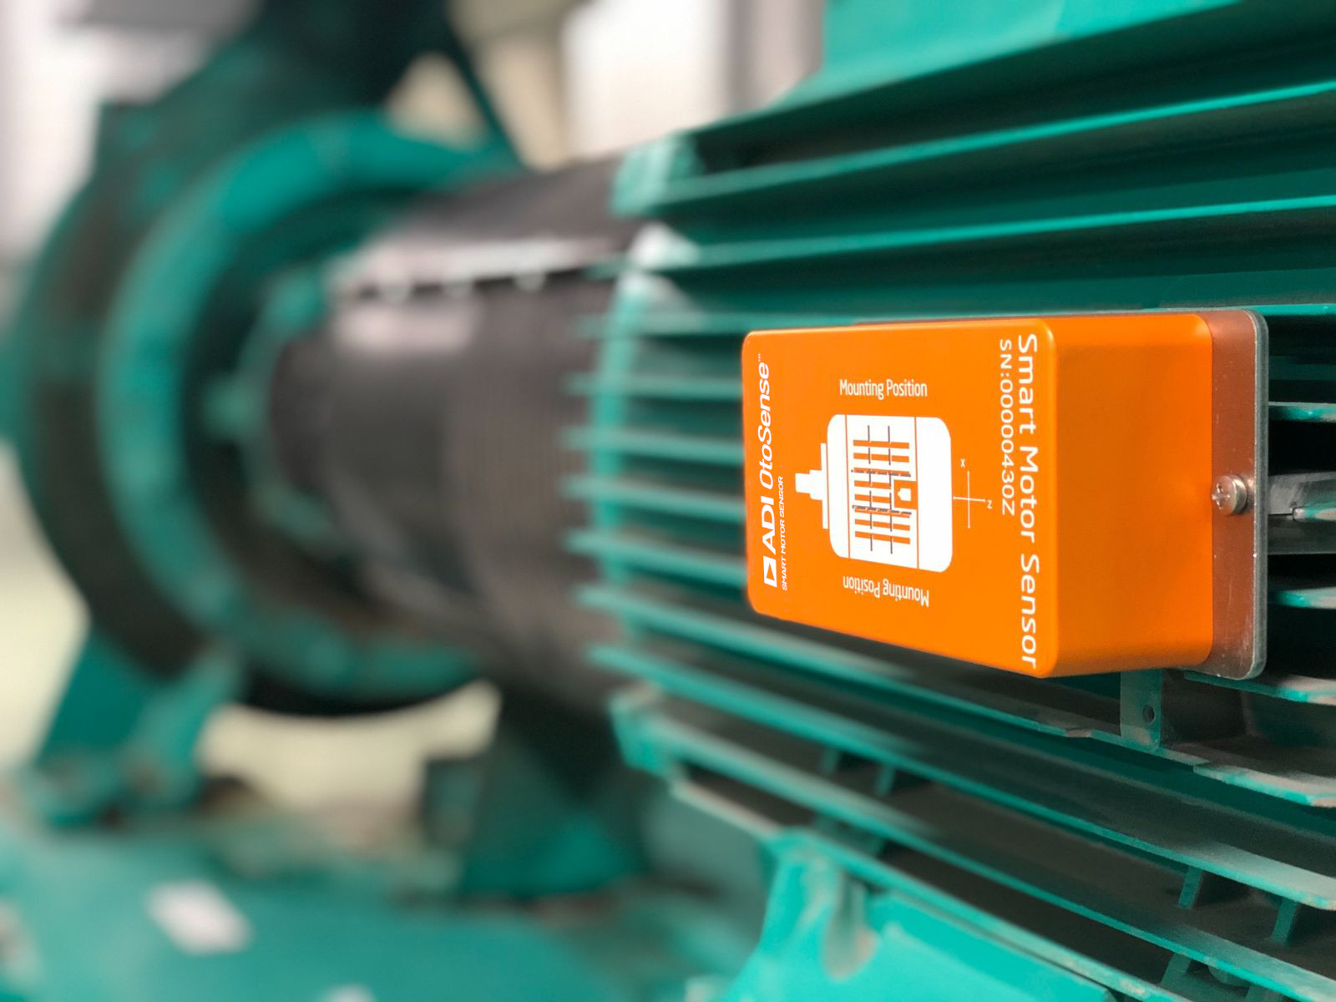
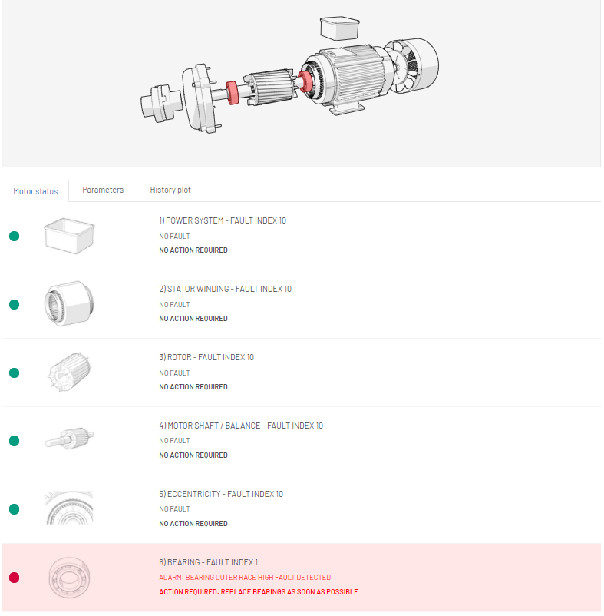
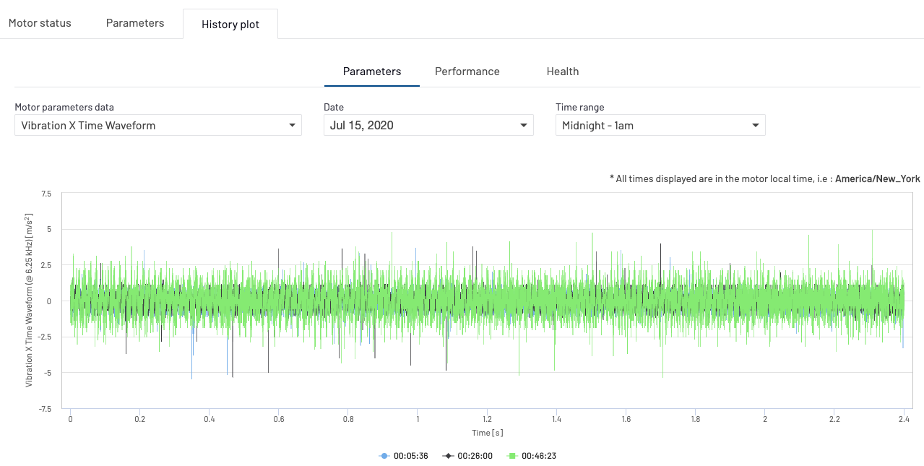
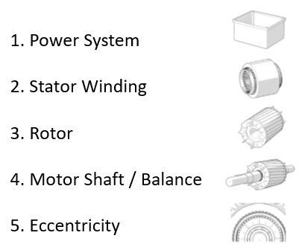
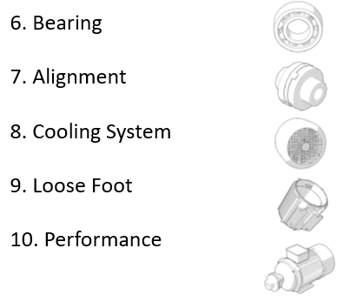
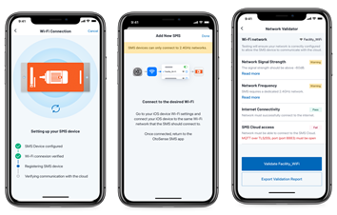
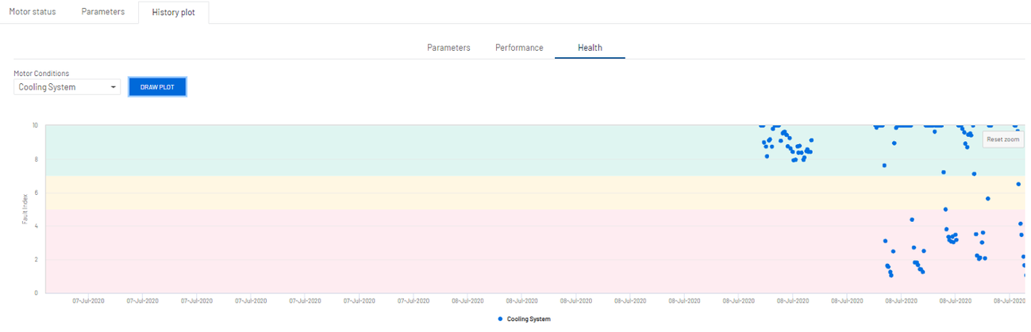
Key Advantages
PARTNER LOGO
HERE
Actionable Diagnostics
Diagnose 9 mechanical and electrical motor faults
Automated
Automatically generated diagnostics and alarms customized to your motor
Scalable
Quick to setup, easy to use
9. Soft Foot
Includes fault severity and recommended actions
Performance indicates potential issues with the load or a change in the process that might require additional action
No need to manually set alarms
No manual device training required
No experts required for initial analysis
Motor agnostic
No wires, no additional gateways required
Easy-to-use interface reduces training and device maintenance
See details of diagnostics
Notes:
Near real-time, best in-class diagnostics to prevent unexpected downtime.​
After an initial learning process, the machine learning models are customized for each motor: the SMS can be installed on any motor, whether new or used. End to end solution – it automatically collects data, provides diagnostics, without additional experts or resources needed.​
Faster time to insight: non-invasive, quick and easy to mount, SMS can be deployed on any low-voltage motor within minutes. Simplified user experience – easy navigation to identify the assets thanks to a tree structure – city > plant name > process > motor name. Allows multiple users with different levels of access.

Slide 10
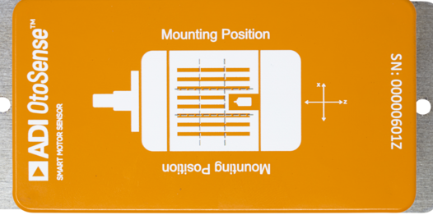
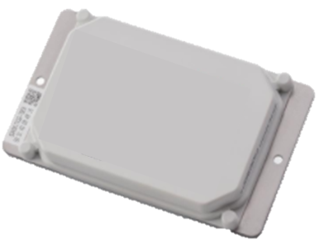
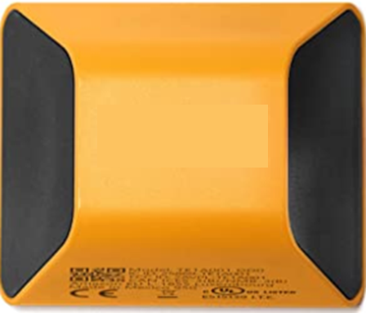

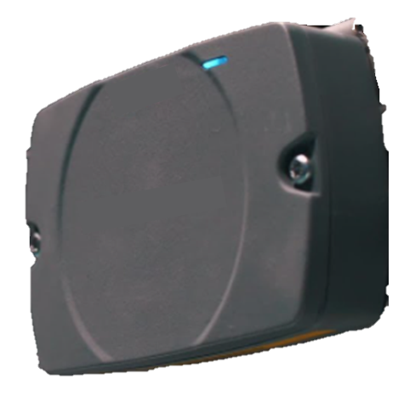
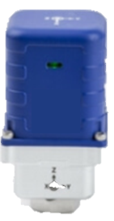
How Our Solution Can Help You
PARTNER LOGO
HERE
Everyone Else…
Actionable Diagnostics
Industry leading 9 motor faults
Electrical & mechanical fault diagnosis
Fault severity
Generic KPIs do not consider system and process interactions
Limited diagnostics based on vibration
You are responsible for training the device
Optimize maintenance decisions
Know what and when to prioritize maintenance activities
Automated
Diagnostic alarms sent directly to you
Automated learning models
Customized for your machine within your environment
You are responsible for setting alarms
You are responsible for training ALL the devices
Experts required for deeper diagnostics
No experts required for analysis
Service your machines only when its needed
Scalable
No wires, no additional gateways
Quick to deploy
Easy to use, intuitive software
Multiple gateways required
Support for training and maintaining devices
Lower Total Cost of Ownership
Reduce costs from additional hardware, training and solution operation
Notes:
Near real-time, best in-class diagnostics ​
After an initial learning process, the machine learning models are customized for each motor: the SMS can be installed on any motor, whether new or used. End to end solution – it automatically collects data, provides diagnostics, without additional experts or resources needed.

Slide 11
OtoSense SMS REST API
Integrating into your Systems
PARTNER LOGO
HERE
RESTful
Secure
OAuth
All the data
Our standardized architecture is accessible and follows industry conventions.
All communications are encrypted end-to-end.
Access is controlled using OAuth 2.0 scoped client credentials over which each customer has full control.
Get access to complete data generated at all stages of the lifecycle.
It's simple to understand, easy to use and painless to integrate

Slide 12
Enabling Organizations to Shape the Future Faster
OtoSense SMS extends ADI’s ability to help leading organizations on their industry 4.0 journey
PARTNER LOGO
HERE
OtoSense Smart Motor Sensor is a connected sensing module that monitors the status and health of low voltage motors in real time.
It relies on temperature, vibration, and magnetic field sensing to diagnose critical motor faults, which enables predictive maintenance so that failure and downtime can be avoided.
It’s an advanced solution to improve the ability to monitor low voltage motors.
Pharma
Food & Bev
Deployed in more than 30 countries across 6 different continents
Utilities
Paper & Pulp
Oil & Gas
Chemical

Slide 13










Analog Devices OtoSense Smart Motor Sensor (SMS)
PARTNER LOGO
HERE
Get real-time insights into 9 different fault types and understand recommended actions to address the faults before failure occurs
“One of the major benefits of this sensor is that you don’t have to set alarm levels. This solution is self-learning. So, you don’t waste time on false positives, and you don’t have to deal with false negatives.
Joris Bracke
Directeur
Bracke EB Groep
Business Impact
Ease of Use
Reliability
Effectively monitor more motors for operations and maintenance planning
Automated diagnostics provide information on critical mechanical and electrical motor faults
No need for costly experts or infrastructure investment
Quick installation and device commissioning combined with automated learning and an intuitive web/mobile app
Enables any user to easily navigate and oversee motor health in the entire facility
Non-invasive installation
Microsoft Azure provides a proven platform for End-to-
End Predictive Maintenance Solutions
Fewer infrastructure requirements improve system operation reliability
Validated operation x-industry
Power system
Asymmetry in motor currents
Rotor
Rotor resistance variation
Eccentricity
Stator/rotor concentricity issue
Cooling system
Motor cooling system problem
Bearing
Failures/defects in bearing
Detectable Motor Faults
Stator winding
Stator resistance variation
Motor shaft/Balance
Gravity center displacement
Alignment
Motor/load misaligned
Soft/Loose foot
Fixing system problems
Notes:
ADI OtoSense is a platform for AI-driven Sensing interpretation.
It acquires signal from the physical world with a main focus on sound and vibration because that’s where most of the insightful information resides, but it can also ingest other types of signals, like pressure, temperature, current or any contextual information that can help interpreting these signals.
OtoSense then featurizes the signal, which means it finds the best features to describe it.
/ 4. It then leverages its Artificial Intelligence to learn the nominal behavior of any machine or process to monitor, and builds an anomaly detection model able to interpret the incoming signal.
By interacting with the people who have the long-learnt expertise on the machines, the AI models can be enhanced. For example, the operator or maintenance technician can label the anomalies that OtoSense detected and teach the AI to recognize and identify these issues in the future. The feedback loop between of technicians to the AI allows for an always better interpretation.
From this platform, ADI developed a turnkey solution dedicated to Electric Motors. This solution is a hardware and software solution that already has built-in domain expertise to provide precise diagnostics out of the box.

Slide 14

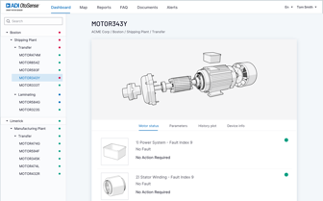
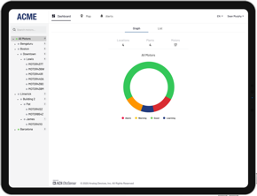



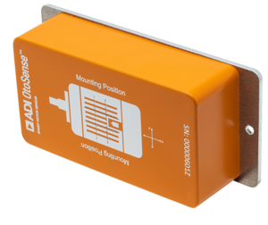
Next Steps
PARTNER LOGO
HERE
Learn More
  Check out the Resource Center for a selection of documentation, guides and videos
Try It!
  Validate ADI OtoSense Smart Motor Sensor performance​
  Experience its intuitive and easy to use interface​
  Test in your environment or in your test lab​
  Realize the SMS' value for your business.Get started with our trial kit: otosense.analog.com/order-now
Notes:
*Types of motors supported:
Three-phase squirrel cage induction electric motors
with frames up to 450 (IEC 600034) or 500 (NEMA MG1)
whose power range varies from 0.37 kW to 500 kW or from 0.5 hp to 700 hp.
driven directly to line (DOL), by frequency inverter (VFD), soft starter, star-triangle drive, or by any other driving device

Slide 15

Thank You!
PARTNER LOGO
HERE

Slide 16
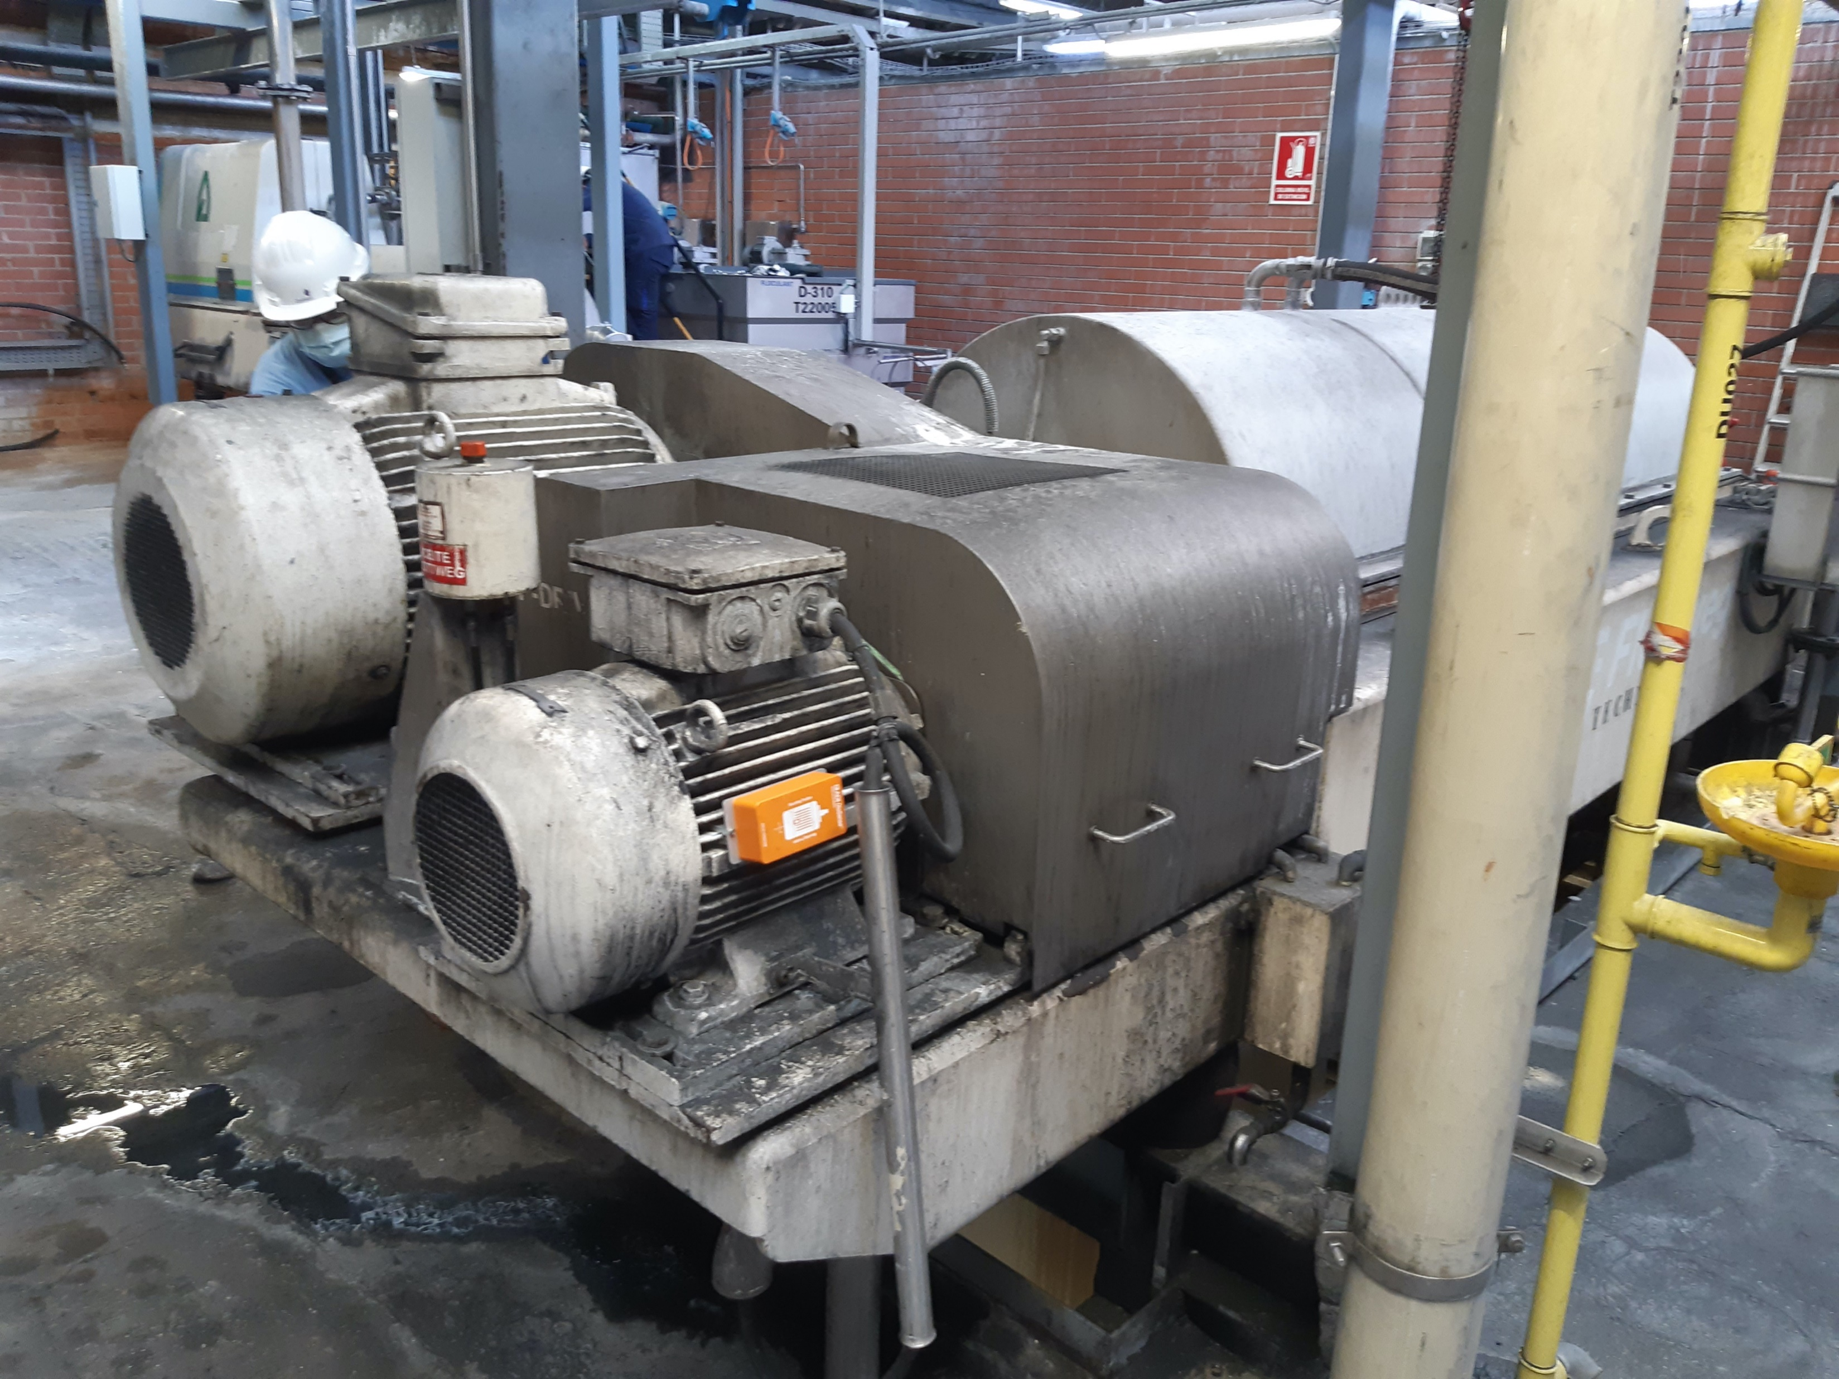
Case Study: Food and Beverage
PARTNER LOGO
HERE
Challenge: Save repair and downtime costs of a centrifugal machine
Years of operating without breakdown
Early warning signs sent by the Smart Motor Sensor enable the maintenance of the machine before it breaks.
2
Downtime and repair costs avoidance /year
Smart Motor Sensor prevents 3 weeks of downtime and the high costs involved in the repair (material, crane, man hours.
100K€
- 90%
Preventive activities
Reduce route-based activities such as regreasing, cleaning of the machine’s filters, vibration analyses.
Notes:
Background: This customer produces lactic acid for the food and pharma industries. In that factory, after the fermentation step, the filtration process starts with two centrifugal machines that run in parallel to each treat half of the production. A third centrifugal machine performs a higher level of filtration to obtain more quantity of product and of better quality.
Challenge: Due to a design flaw, this third centrifugal machine breaks down at least once a year because of a bearing lubrication problem, and it remains down for three weeks each time. This results in significant costs, not only because of the repair itself (materials such as crane, labor hours, etc. ~50K euros), but also because of the impact on the production of the machine's downtime (~50K euros as well). ​
As this is a recurring problem and the built-in warning system does not allow for an emergency stop of the machine, teh company (Corbion) needs to know in advance when the lubrication system is about to fail in order to stop the machine and do its maintenance in time, before the bearings and main shaft break. ​
OtoSense SMS monitors this machine in real time and alerts the maintenance team when the level of vibration and the ambient temperature reach a critical level, in order to stop the machine in time, before it breaks.
In addition, instead of each week cleaning the filters, re-greasing the bearings and manually checking the vibrations, the maintenance team can extend the frequency of this activities by checking the smart motor sensor's insights.

Slide 17
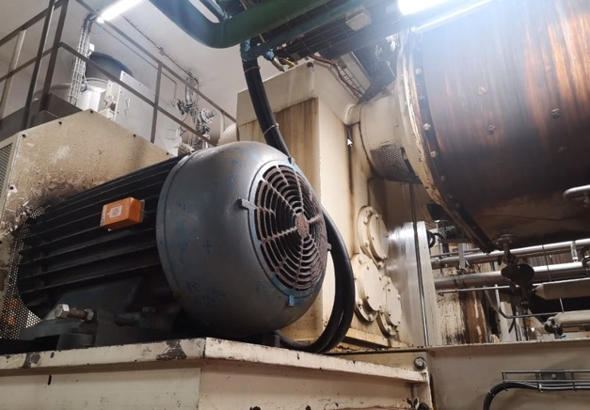
Case Study
PARTNER LOGO
HERE
USE CASES
IMPLEMENTATION & SUCCESS
Improve asset predictive maintenance throughout WW factories.
Generate cost savings from maintenance efficiencies.
Pre-production deployment testing for final IT validation in key facilities responsible for global digitalization efforts.
SMS detected a mechanical looseness (Soft foot), on important asset from manufacturing process.
OUR SOLUTION
Diagnostics
Best-in-class as confirmed by customer
Automated Solution
No need for additional expert analysis
Scalable and Secure
Easy install, no gateways, intuitive SW
One of the largest food and beverage makers in the world
Page 17 | Analog Devices | 2021

Slide 18
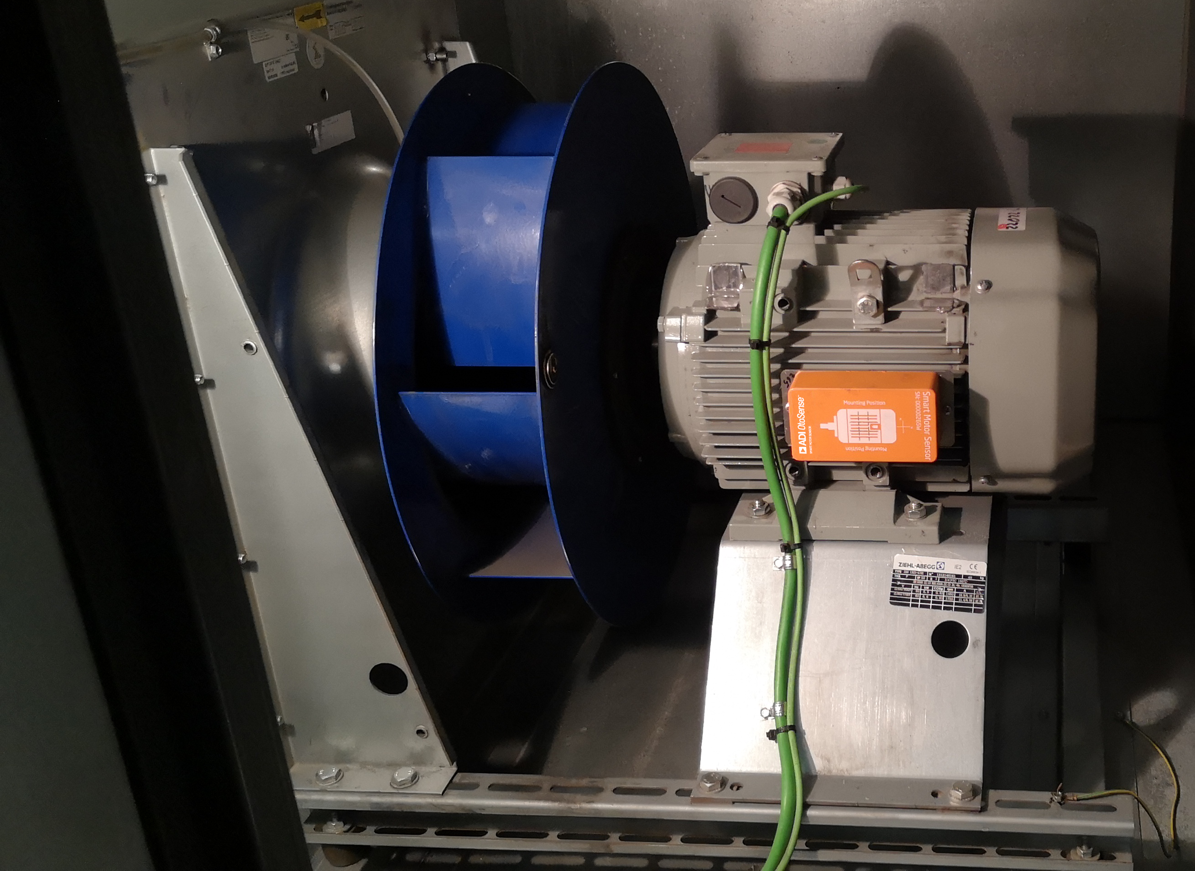
Case Study: Pharma
PARTNER LOGO
HERE
Challenge: Ensure stable temperature in the manufacturing space to guarantee the quality and reliability of the products.
- 80%
Unplanned downtime and production loss
Early detection of potential failures allows for planning the maintenance.
- 95%
Reduction in preventative activities
Reduce route-based activities such as quarterly vibration analyses.
- 40%
Reduction of frequency overhauls
Maintenance and repairs are done only when necessary.
Notes:
Leader in the pharmaceutical and chemical industry, the client still relied on preventive maintenance to monitor the environmental conditions of their manufacturing and storage areas. The pharmaceutical industry is subject to very strict rules to ensure product quality and reliability: controlling the temperature is critical to comply with the industry's regulations.
Use case: Monitoring of Air Treatment Units (ATU), compressors, pumps, and conditioning turbines.
These machines run 24/7 and can be stopped only once or twice a year for a planned overhaul. Unexpected downtime of this equipment generates very high costs, as it results in temperature fluctuations, causing product spoilage and potential health hazard if it goes unnoticed.
Their goal: better anticipate equipment downtime and more effectively schedule maintenance and repair.
A few months after the installation, SMS detected a significant increase in vibration and identified a fault on the bearings. An alert was generated and sent through the mobile application and by email, along with the recommendation to check the bearings and lubrication conditions.
The severity level of the fault indicated that the failure was not imminent, which allowed the manufacturer to serenely empty the storage room before inspecting the turbine.
During this inspection, the maintenance team confirmed the worn condition of the bearings and preemptively changed them.
When the replacement is made, SMS enables the control of the repair by verifying that the vibration levels are back to normal. As no further warning is sent, the manufacturer can be confident that the machine will continue to operate until further notice.

Slide 19
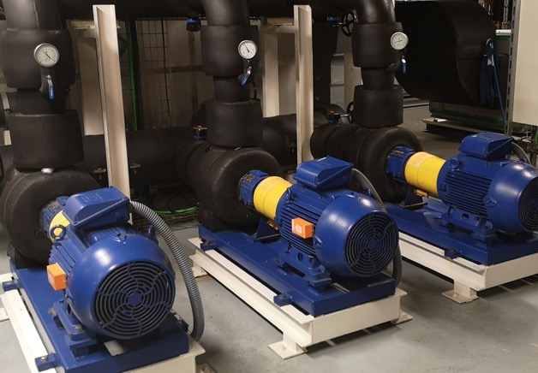
Case Study
PARTNER LOGO
HERE
USE CASES
Continuously monitor equipment to ensure process stability
Improve maintenance decisions through predictive and historical data
IMPLEMENTATION & SUCCESS
Deployments in main production facility in Spain.
Global expansion in progress in EU with potential in NA.
Bearing situation on critical asset was managed, based on clear diagnostics provided by SMS.
OUR SOLUTION
Fault Severity
Maintenance and repair urgency
Automated Diagnostics
No additional analysis required
Continuous
Real-time diagnosis of all motors in the field
Multinational pharmaceuticals and chemical manufacturer

Slide 20
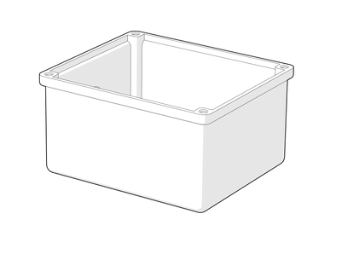
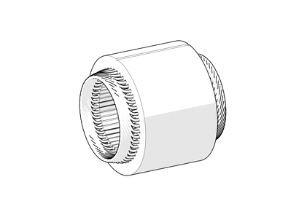
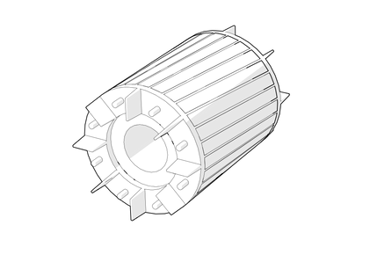
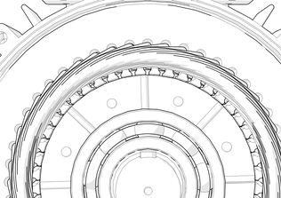
Faults Detected
PARTNER LOGO
HERE
Power System
Electrical: Problems in the three phases of the power supply (imbalance of the three phases, current), lost phase.
Electrical: Short circuit inside one phase of the motor, insulation problems between the coils, increases currents and creates an imbalance on the three phases.
Stator Winding
Rotor
Electrical: Broken rotor bar; Air bubbles detected on material structure of rotor.
Eccentricity
Mechanical & Electrical: gap between the rotor/stator changes, (dynamic) potentially from bent shaft; (static) improper bearing installations creating some alignment issues internal to the motor.

Slide 21
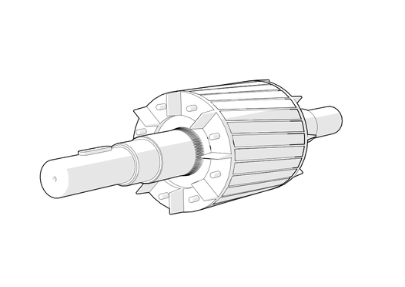
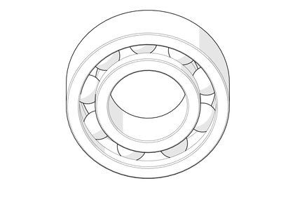
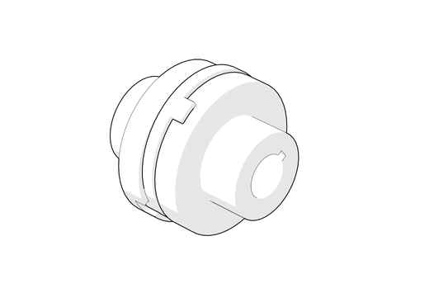
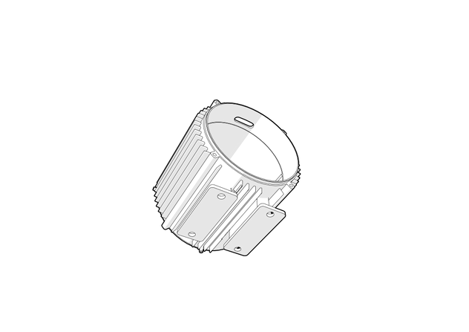
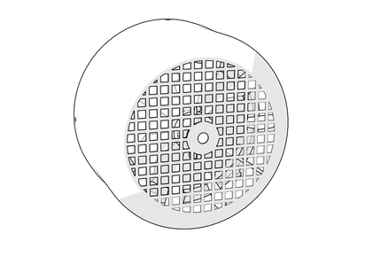
Faults Detected
PARTNER LOGO
HERE
Motor Shaft/
Balance
Mechanical: Unequal distribution of mass that causes the load to shift from the center of rotation. Rotor flexion.
Bearing
Mechanical: Mechanical stresses or contamination can lead to small cracks or defects that occur in the bearing, creating vibration.
Mechanical: Occurs when two rotating shafts (motor and the load) are not aligned, external misalignment. Different from eccentricity which is internal to the motor.
Misalignment
Mechanical: Structural looseness occur when the motor base or connection to the motor base are not secure. This poor connection results in excess vibrations.
Loose/Soft Foot
Temperature: Applicable to motors cooled with an external fan; can determine problem with the fans attached to the shaft or externally attached to the motor.
Cooling System

