Slide 1
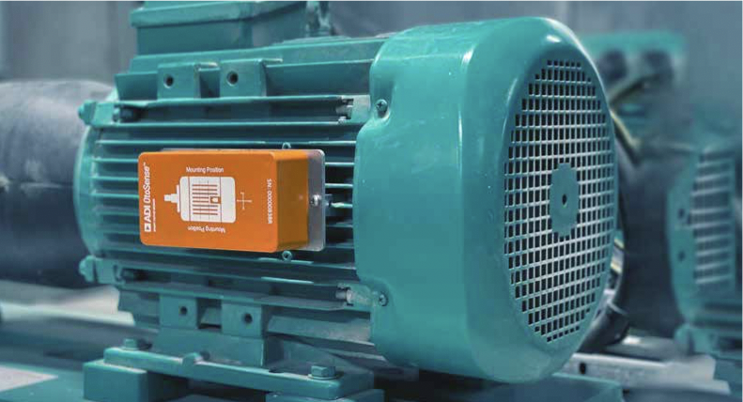
Partner Logo Here
Insert Partner Logo in JPEG or PNG Format
Why Customer use
OtoSense Smart
Motor Sensor
Sensing Interpretation
At its best
Reduce unforeseen
Costly downtimes
Better manage spare
Parts and stock
Optimize Maintenance
Scheduling and
Resource allocation
In Manufacturing, millions of low voltage motors operate unmonitored,
Impacting the motor efficiency, process operation and load performance.
Real-time monitoring of motor health reduces maintenance, operating
and warranty costs
Detectable
Motor Faults
What is the Smart Motor Sensor (SMS)?
Power System
Asymmetry in motor currents
ADI OtoSense ™ Smart Motor Sensor is a full turnkey hardware and software solution that helps avoid downtime and optimize maintenance cost. The device sends sensing data to a cloud where AI provides diagnostics and delivers prescriptive maintenance actions via a web platform and mobile app.
Stator winding
Stator resistance variation
Rotor
See Smart Motor Sensor real-time monitoring in action
Rotor resistance variation
Diagnostic
Automated
Scalable
Motor shaft/Balance
Optimize maintenance
scheduling and resources
allocation
No need to set
alarm thresholds
manually
Works with all low
voltage asynchronous
motors
Gravity center displacement
Eccentricity
Includes severity level and
recommended actions
No manual device
training required
No wires, no additional
gateways required
Stator/rotor concentricity issue
Performance indicator
identifies potential issues
with the load
No expertise
required for initial
analysis
Easy to use interface
reduces training and
device maintenance
Alignment
Motor/load misaligned
Cooling System
[E.g. “Most predictive analytics solutions in the facilities industry depend on integration with building automation systems. OtoSense let’s building owners inexpensively remotely monitor critical motors without expensive wiring & system integration, and often when no BAS exists.”
Motor cooling system problem
Soft/loose Foot
Name
Position Partner Name]
Info needed for this section: Quote
Partner Phone Number Partner Email Address
Fixing system problem
Bearing
Start your Industry 4.0 journey today
Failures/defects in bearing
Call us at X-XXX-XXX-XXXX or email us at info@partneremail.com to
find out more
2022 © Analog Devices Inc. All Rights Reserved
www.otosense.analog.com

Slide 2
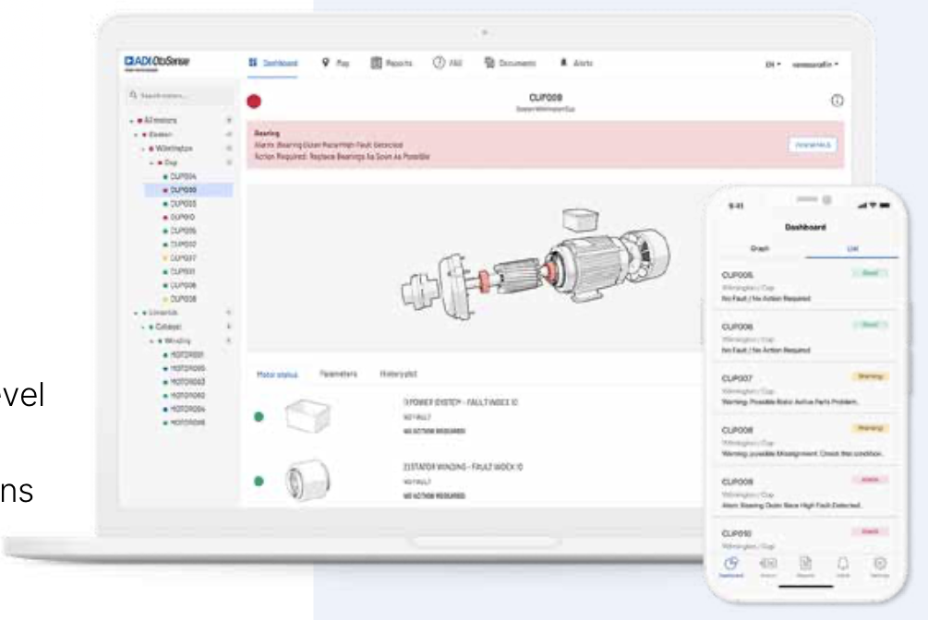
Smart Motor Sensor deployed by Partner Name enables the automated monitoring of your operation 24/7
Ensure continuity of operations
Better informed maintenance decisions:
early detection of potential failures and severity level
allows for planning the maintenance
AI diagnostic and prescriptive maintenance actions
Savings on unplanned downtime costs
And unnecessary preventive maintenance
Protected data to actionable insights
Our promise to you
Software framework built on a secure foundation
Security protocols ensure accurate, reliable and
protected data and insights, throughout the entire SMS
data lifecycle
ADI OtoSense Smart Motor
Sensor is the most accurate
solution on the market to
sense and interpret your
machine data. This is why we
define ourselves as sensing
interpretation experts.
At the cutting edge
80% avoided unplanned downtime costs
Partner Name manages the infrastructure
allowing Analog Devices to devote more
resources to the development of new features
Diagnostic and prescriptive maintenance actions
An offer to get
You started
Why Analog Devices and Partner Name?
ADI OtoSense allows your domain experts to give the raw sensor data
meaning. Asset behaviors, normal and abnormal, are automatically
detected by OtoSense machine learning then identified and tagged by your
machine experts. The software is taught to reliably predict and diagnose
issues by those who know your assets best – the people who have built
Their careers understanding your machines. Competitive offerings require
powerful computers and more data to be sent to the cloud. ADI OtoSense
can be customized and packaged to create turnkey solutions or deployed
independently to complete any existing platform.
OtoSense Smart Motor Sensor
optimizes your production
environment and reduces
breakdowns using robust
condition-based monitoring
hardware and software.
Realize benefits such as
lowering asset maintenance
Costs, extending equipment
life, and increasing uptime.
Information about partner to include years experience and areas of
specialization.
[E.g. With XX years experience in servicing the industrial market with
cutting-edge equipment, we are ideally positioned to exploit the
rapidly growing demand for IoT devices such as the Smart Motor
Sensor for condition-based monitoring of electric motors. As industry
harnesses the power of Industry 4.0, we look forward to bringing this
crucial technological development to industry.]
Free trial
Explore Smart Motor Sensor
with a trial offer
Partner Logo Here
Insert Partner Logo in JPEG or PNG Format
otosense.analog.com/order-now

